Slide 1
BFO-SCO-UFO
SCO V1.0.0. Alignment
to
Unified Foundational Ontology (UFO)

Slide 2
Goal
The Sustainability Core Ontology (SCO) currently employs Basic Formal Ontology (BFO) as the upper-level ontology.
This work explores and sets directions for aligning SCO to other Top-Level Ontologies (TLOs), specifically the Unified Foundational Ontology (UFO).
UFO OWL version: gUFO.
Towards SCO V1.1.0.
SCO-B (B for BFO): alignment to BFO.
SCO-U (U for UFO): alignment to UFO.
Goal: to ensure SCO leverages and incorporates different ontological perspectives to establish a common reference hub for sustainability.

Slide 3
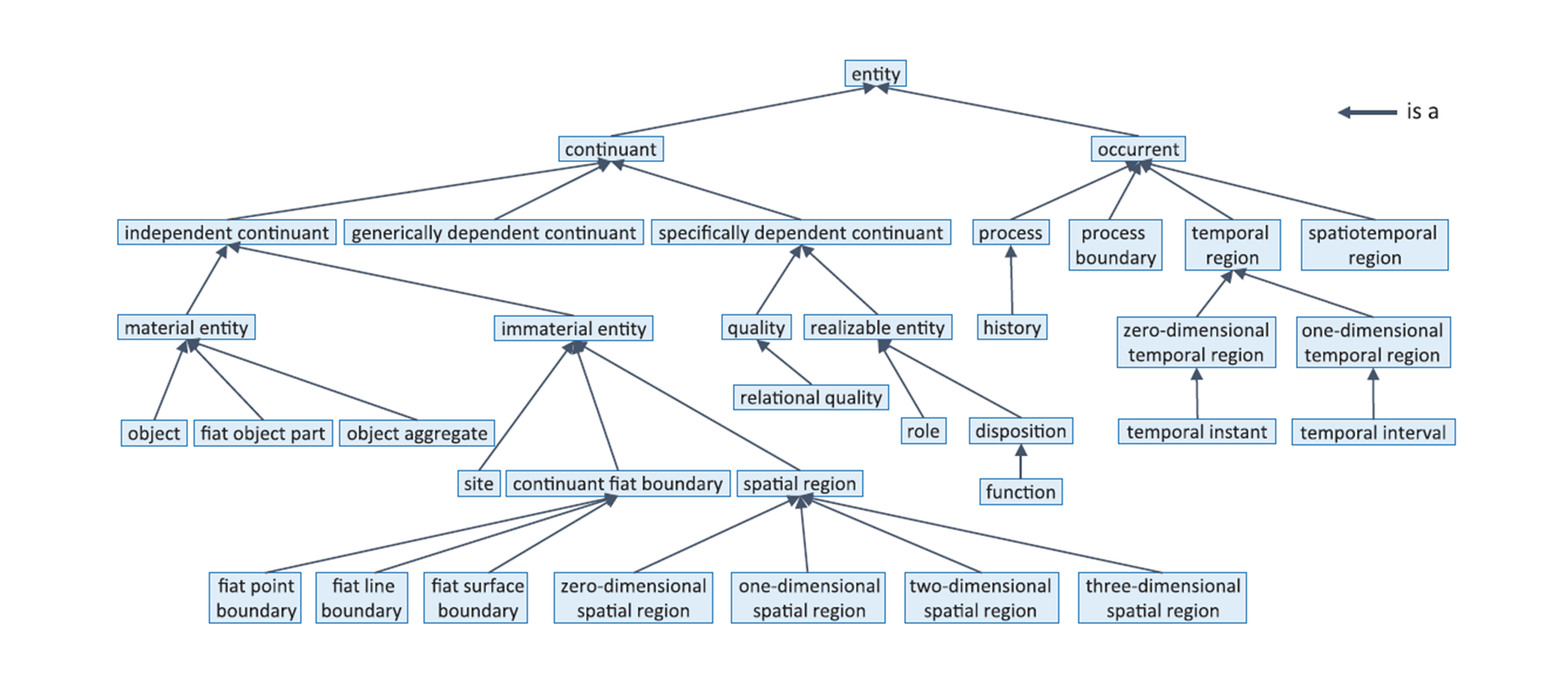
BFO
From ISO/IEC 21838-2:2021, 2021

Slide 4
UFO
From Guizzardi et al. (2022)

Slide 5
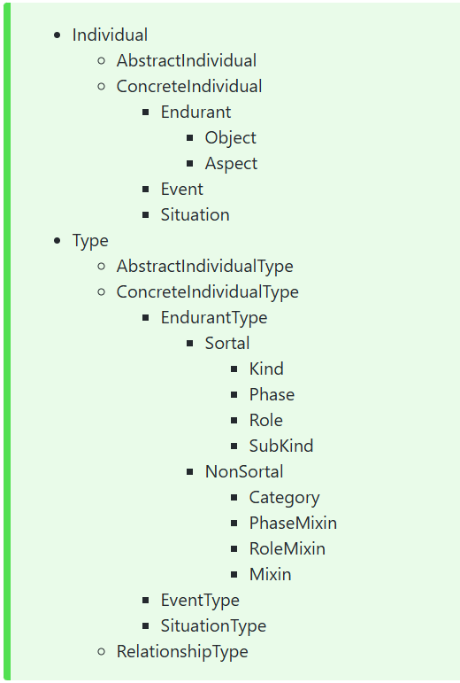
gUFO
From https://nemo-ufes.github.io/gufo/

Slide 6
SCO-B and SCO-U
SCO-B aligns the SCO vocabulary with BFO.
This segment corresponds to SCO V1.0.0.
SCO-U aligns the SCO vocabulary with gUFO.
Alignment performed as a translation process from an SCO BFO-compliant representation to an SCO UFO-compliant representation.
See the next slides for details.
We construct the alignments using Protégé.

Slide 7
SCO-U Translation Methodology (work in progress)
gUFO Import
Hierarchization
Example: SCO “complex system” class.
1) Background assessment
Evaluating the position of SCO “complex system” class in the BFO hierarchy.
(to use the materials documented in the “references” slide as a reference point.)
Subclass of the system class (subclass of “material entity” BFO class).

Slide 8
2) Exploration of correspondences
Identification of the rough corresponding class position into the gUFO “individual” class hierarchy.
(to use the materials documented in the “references” slide as a reference point.)
To position under the “endurant” -> “object” branch of the “individual” gUFO class hierarchy.

Slide 9
3) Construction of SCO-gUFO “individual” class hierarchy
Identification of adequate upper-level class(es) into the gUFO “individual” class hierarchy.
(to use the materials documented in the “references” slide as a reference point.)
Subclass of: “object” gUFO class.
In Protégé: to add the SCO “complex system” class is_a (subclassOf) gUFO “object” class assertion.

Slide 10
4) Construction of SCO-gUFO “type” class hierarchy
Identification of the “type” class that the SCO “complex system” class instantiates into the gUFO “type” class hierarchy.
(to use the materials documented in the “references” slide as a reference point.)
gUFO “phase”.
In Protégé: to create a corresponding individual (same class URI, Punning).
In Protégé: to add the SCO “complex system” individual rdf:type gUFO “phase” class assertion.
In parallel: to carry on discussions with subject matter experts.

Slide 11
work in progress
Axiomatization

Slide 12
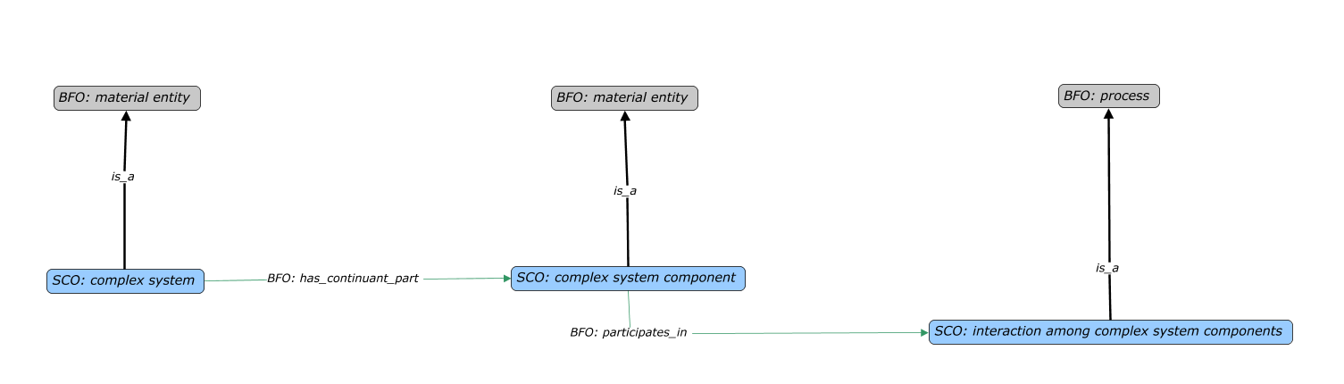
Example: Complex System, Components, and Interactions
The SCO representation that is BFO compliant. We omitted intermediate classes.

Slide 13
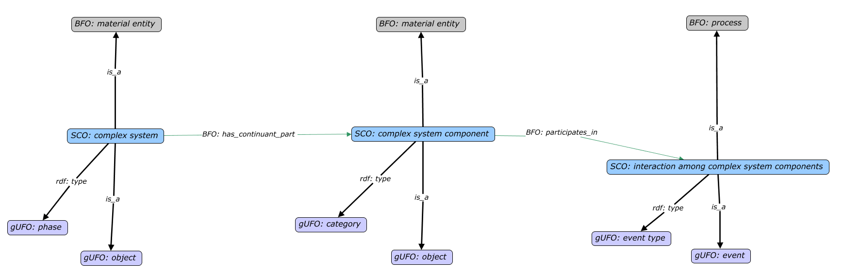
Work in progress
The SCO representation that is BFO and UFO compliant.

Slide 14
work in progress
Final steps
Removal of BFO classes
Removal of BFO-compliant axiomatization.
SCO-U Validation
Ontology validation using HermiT 1.4.3.456 reasoner and gUFO Rule validator.

Slide 15
References
Arp, R., Smith, B., & Spear, A. D. (2015). Building ontologies with Basic Formal Ontology. Massachusetts Institute of Technology.
Guizzardi, G., Botti Benevides, A., Fonseca, C. M., Porello, D., Almeida, J. P. A., & Prince Sales, T. (2022). UFO: Unified Foundational Ontology. Applied Ontology, 17(1), 167–210. https://doi.org/10.3233/AO-210256
gUFO and gUFO.ttl.
COVER (COVER.ttl).

